Slide 1


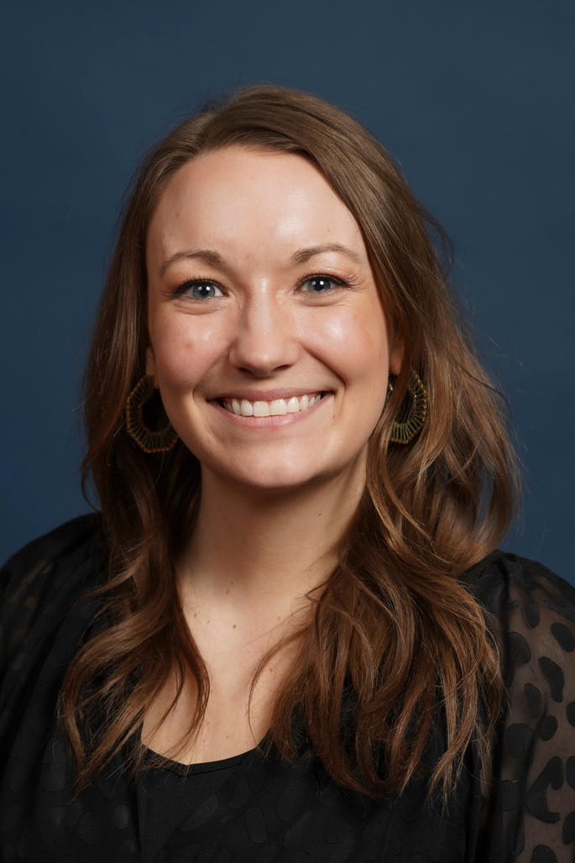
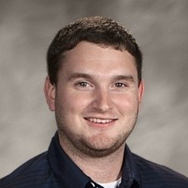
Starting Strong: Tools and Insights for CE Professionals
YOUR ROADMAP FOR THE FIRST 18 MONTHS
Morgan Anderson
Assistant Dean
Lucas Peterson
Director, Camps and Conferences

Slide 2

THE CE LANDSCAPE: IT’S DIFFERENT HERE
CE is a Bridge:
  Connecting the academic world with real-world needs
You Wear Many Hats
  Program Manager, Marketer, Instructional Designer, Budget Analyst, Relationship Builder
The Bottom Line Matters:
  Often entrepreneurial and revenue-driven. We operate like a business within the university.
Speed & Agility
  We move at the speed of the market, rarely at the speed of traditional higher ed.
Higher Education
CE
Business/ Industry

Slide 3

YOUR 18 MONTH ROADMAP
Months 1-3: The Sponge Phase
  Focus: Listen, Learn, Ask Questions.
  Goal: Understand processes, history, and key players. Avoid the urge to "fix" anything yet.
LEARN FROM MORGAN.

Slide 4
YOUR 18 MONTH ROADMAP
Months 4-9: The Connector Phase
  Focus: Build Relationships, Identify Opportunities.
  Goal: Execute your plan. Begin to map stakeholder needs to CE capabilities.
LEARN FROM LUC.

Slide 5
YOUR 18 MONTH ROADMAP
Months 10-18: The Contributor Phase
  Focus: Propose, Pilot, Innovate.
  Goal: Use your knowledge and network to launch a small new initiative or improve an existing process.
LEARN FROM MORGAN.

Slide 6

YOUR #1 PRIORITY:
MANAGING YOURSELF
Balancing, Boundaries & the “Yes” Trap
  Learn to say: “That’s a great idea, let me check my project load and see where this fits”
  The power of saying “No” or having a “no person”
  Protect your time for deep work and block off your calendar
  Ask questions and clarify:
    “What does success for this project look like?”

Slide 7

YOUR #1 PRIORITY:
MANAGING YOURSELF
Set Your Professional Development Goals
  Identify 1-2 skills you want to build this year
  Find a mentor, whether inside or outside of your organization
  Join a professional Organization (UPCEA, ACCED-I, ACA, MEMS)

Slide 8
PD OPPORTUNITIES
  Professional Organizations:
    UPCEA
    ACCED-I (Association of Collegiate Conference and Events Directors-International)
    American Camps Association (ACA)
    OLC (Online Learning Consortium)
    ACHE (Association for Continuing Higher Education)
  Recommended Reading:
    QBQ The Question Behind the Question by John G. Miller
  Productivity Tools:
    Project Management: Monday.com, Asana
    Team Communication: Webex, Slack, Microsoft Teams

Slide 9

YOUR #2 PRIORITY:
MANAGING RELATIONSHIPS
Faculty
Finance
Industry
Partners
Marketing
You/CE
WHO ARE YOUR
KEY PARTNERS?
Community
Orgs
IT

Slide 10
YOUR #2 PRIORITY:
MANAGING RELATIONSHIPS
Faculty
Internal Partners: Your Campus Lifelines
  Faculty/Instructors
  Marketing and IT
  Finance
Marketing
External Partners: Your Growth Engine
  Companies, non-profits, government agencies
  Listen more than you talk: What are their pain points?
IT
WHAT HAPPENS WHEN EXTERNAL PARTNERS BECOME YOUR INTERNAL STAKEHOLDERS?

Slide 11
YOUR ACTIONABLE TOOL
The Goal: Proactively build your internal and external network.
  Make a List:
    Brainstorm 30 people on and off campus you should know.
  The Ask: Send a simple email.
    "Hi [Name], I'm new to the CE team and I'm hoping to learn more about how your department works. Would you be open to a 20-minute chat in the coming weeks?"
  The Agenda: Have 2-3 questions ready.
    "What's the most common way your team works with CE?"
    "What's the biggest challenge you're facing right now?"
    “How can I help you/your department?”
  The Follow-Up: Send a thank you note.

Slide 12

YOUR NEXT STEP
Write down 3 people for your first CE chats and send the invitation.
Here’s where we would start.

Slide 13



KEY TAKEWAYS
Embrace the CE Mindset
You are an entrepreneurial bridge-builder.
Manage Yourself First
Set boundaries and own your professional growth.
Build Your Network Proactively
Your relationships are your greatest asset.

Slide 14
LET’S CONNECT!
Lucas Peterson
Director, Camps and Conferences
petersol@uww.edu
Morgan Anderson
Assistant Dean
andersml@uww.edu
THANK YOU!

